Slide 1
Aircraft Construction
Aerospace Manufacturing Core Study Guide
“AMCSG-102”
Introduction to Aerospace Manufacturing

Slide 2
Airframe Construction

Slide 3
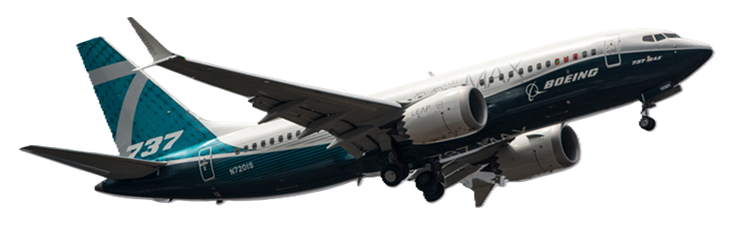
Airframe
An airframe is the main structural components of an airplane:
Tail Assembly
Wings
Fuselage
(CC2) Wikimedia Commons, 2018
Elevator
Landing Gear
Notes:
Image Credits:
Google "boeing.com 737 max” = (CC2) - https://commons.wikimedia.org/wiki/File:EGLF_-_Boeing_737_Max_-_N720IS_%2841646299740%29.jpg

Slide 4
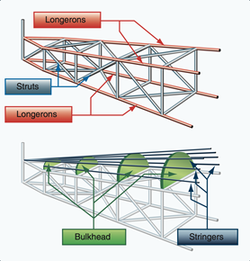
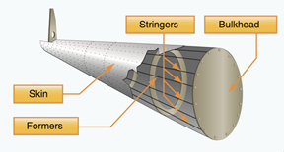
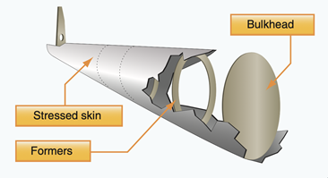
Fuselage Construction: Three Types
Text from ChatGPT
Truss Structures
Material: Wood, steel or aluminum
Design: Rigid frame, lacks aerodynamic shape, geodesic too
Older or smaller lightweight planes
Material: Aluminum or composite
Design: Skin supported by frames, stringers, and bulkheads to better handle stress & damage
Most popular today for commercial airplanes
Material: Plywood, fiberglass, composites
Design: Single integrated shell is the structure (no stringers)
Difficult to build, less common for commercial airplanes (787)
(PD) U.S. Government
Semi-Monocoque:
(PD) U.S. Government
Monocoque Shell:
(PD) U.S. Government
Notes:
Image Credits:
Truss Image = US Gov = Public Domain = https://commons.wikimedia.org/wiki/File:Truss-type_fuselage_structure.png
Monocoque Image = US Gov = Public Domain = https://commons.wikimedia.org/wiki/File:Monocoque_fuselage_design.png#filelinks
Semimonocoque Image = US Gov = Public Domain = https://commons.wikimedia.org/wiki/File:Semimonocoque_fuselage_design.png

Slide 5
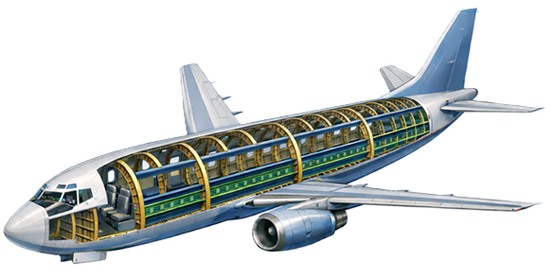
Fuselage Construction: Bulkheads & Formers
Text from ChatGPT
Bulkhead
Location: Transverse, solid disc, few
Strength: High
Primary Purpose: Pressure seal, heavy loads, attach wings or tails
Secondary Purpose: Mounting longerons & stringers, shape fuselage
Formers (almost same as bulkhead)
Location: Transverse, open ring, many
Strength: Medium
Primary Purpose: Mounting longerons & stringers, shape fuselage
Formers
ChatGPT / Matt Pierce, 2026
Bulkhead
Notes:
Image Credits:
ChatGPT = licensed to me “make a diagram showing the airframe components bulkheads, formers, longerons and stringers in semi-monocoque boeing jet. Use callouts.”

Slide 6
Fuselage Construction: Longerons & Stringers
Text from ChatGPT
Longerons
Location: Longitudinal, large, few
Strength: High
Primary Purpose: Main bending/torsion loads
Stringers
Location: Longitudinal, small, many
Strength: Low
Primary Purpose: Local stiffening, skin support
Longerons
ChatGPT / Matt Pierce, 2026
Stringers
Notes:
Image Credits:
ChatGPT = licensed to me “make a diagram showing the airframe components bulkheads, formers, longerons and stringers in semi-monocoque boeing jet. Use callouts.”

Slide 7
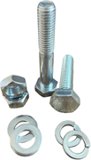
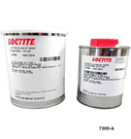
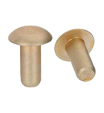
Fuselage Construction: Skin & Fasteners
Text from ChatGPT
Skin
Location: External shell, many small sections
Strength: Moderate
Primary Purpose: Aerodynamic shape, pressure seal, strengthens airframe
Fasteners
Location: Everywhere!
Strength: Low, Moderate, Strong
Primary Purpose: Bolting together large components heavy load, screws or rivets to fasten smaller components under low to moderate load
Skin
ChatGPT / Matt Pierce, 2026
Rivets | Bolts | Screws | Adhesives
(Ad) Aircraft Spruce
(Ad) GStatic
(Ad) Sky Geek
(Ad) Fibre Glast Devs
Notes:
Image Credits:
ChatGPT = licensed to me “make a diagram showing the airframe components bulkheads, formers, longerons and stringers in semi-monocoque boeing jet. Use callouts.”
Rivet photo = (Ad) - Shopping at AircraftSpruce and Specialty “https://www.aircraftspruce.com/catalog/pnpages/AN470A-6-10.php?utm_source=google&utm_medium=organic&utm_campaign=shopping&utm_term=AN470A-6-10”
Titanium Bolt Photo = (Ad) - Shopping - https://encrypted-tbn0.gstatic.com/shopping?q=tbn:ANd9GcQdkwBTBZcncE7A63si5mJcwRQQS72hApd2RD5iTzkQFr4ua48-oC8Do-vu0cnXqGRIoWqi3q--dKeiOoJQcRuvnD8AlVBMMCkEJ5LQ_6o9phYkFii6LyA3JjU
Screw Photo = (Ad) - Shopping at SkyGeek - https://cdn11.bigcommerce.com/s-jifykode7m/images/stencil/1000w/products/101668/169815/SGP139998_1_main__23195.1698700520.jpg?c=1
Adhesive Photo = (Ad) - Shopping at Fibre Glast Developments - https://encrypted-tbn3.gstatic.com/shopping?q=tbn:ANd9GcQ3OPpIE6lBXNh4Iw_fcBRR1Lm18OxIF-nBLPXvsa0Y7VXgX7LwyLEzVjXYFU6E0nv9P2YD5TFE1KsHI63f5X74FjZB-KfzMOhIB-1SHDtplyp7Iux_U8ha

Slide 8
Wing Construction

Slide 9
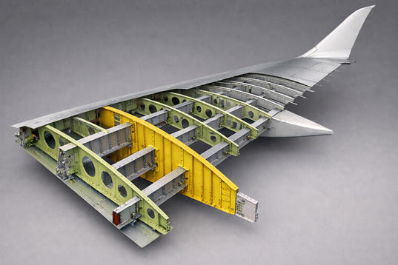
Wing Construction: Spars, Ribs, & Stringers
Text from ChatGPT
Spars
Parallel to wing, at least two (front/rear)
High strength, flexible
Main structural part of wing
Ribs
Perpendicular to wing, many
Structural cross members (leading to trailing edge)
Creates shape and contour of wing
Transfer loads from skin to spars and stringers
Stringers
Parallel to wing, many (ChatGPT not draw, so I mocked black line)
Upper and lower stringers exist
Attachment points for wing skin
Not load bearing
Spars
Stringers
ChatGPT / Matt Pierce, 2026
Ribs
Notes:
Wing Diagram: Chat GPT, many passes and dead ends…this was the best combination…no copyright for AI gen drawings per their documentation…I did this on home computer outside of work.
“draw an a boeing commercial airplane wing construction showing spar, longerons, ribs, and skin”
“remove the labels and arrows. show wing spars, wing stringers, wing ribs, and wing skin”

Slide 10
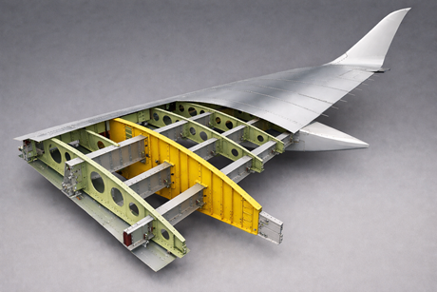
Wing Construction: Wing Skins
Text from ChatGPT
Wing Skin
Many small sections, riveted on
Aerodynamic shape critical to provide lift
Light, rigid, easy to bend and shape
Types:
Aluminum Wing Skin
Honeycomb layer sandwiched between upper/lower sheets
Less expensive than composite
Carbon Fiber Wing Skin
Stronger than metallic skins, lasts longer too
More expensive to build
Fiberglass Wing Skin
Smaller surfaces: ailerons, flaps
Skin
ChatGPT / Matt Pierce, 2026
Notes:
Wing Diagram

Slide 11
Factory Safety

Slide 12
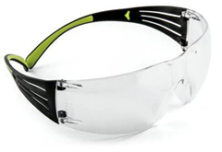
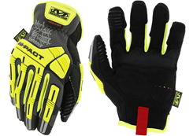
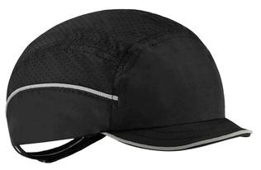
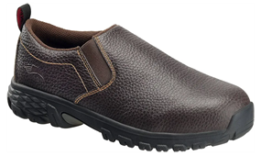
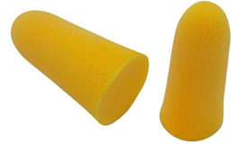
Factory Safety (1 of 2)
Many safety rules specific to use of tools…
Always wear eye protection in the factory (flying particles, molten metal, dangerous liquids, etc.)
May need head protection
May need ear protection
May need hand protection
May need foot protection
Work Instructions indicate what safety equipment to wear
(Ad) Aircraft Spruce & Specialty
(Ad) Mechanix Wear
(Ad) Premier Supplies
(Ad) Lehigh Safety Shoes
(Ad) PilotMall.com
Notes:
Eye protection: Shopping “Aircraft Spruce and Specialty” = https://encrypted-tbn1.gstatic.com/shopping?q=tbn:ANd9GcSRlDnva0_BDpWJ1StbgkAHFAFUIV5zJQJ1eqTTgYTJG8N2D0jLb6mkOC9Snevt92ebeGzBXdi2Xyb9Epjd8gn4UdsOdDdb
Ear Protection “PilotMall.com” shopping site: https://encrypted-tbn1.gstatic.com/shopping?q=tbn:ANd9GcSzYgm2YBUSVHYbdtCbpswmj9BITisaFih-V03AiJndE-FATBS2EuHyORPk4eXg-XMzrs4DqQuhzlmDWRhbc-4pwFrVcvVL
Head Protection: “Bump cap” for sale at Premier supplies website: “https://content.etilize.com/Alternate-Image1/1068706382.jpg”
Hand Protection: Mechanix Wear website for sale. “https://encrypted-tbn1.gstatic.com/shopping?q=tbn:ANd9GcTstZGsuJ_IP29iP59mYuWnp5ko2iNCmGJ-5j5TVdPtLwdf6HuUuWrmqW0vrGYY2il0Zrb4yUQ72qtatkypeZxprfhjQZIlp3f_kk4YHhSG”
Foot Protection (steel towed boots?): Lehigh safety shoes (Aluminum toe! Cool). “https://encrypted-tbn2.gstatic.com/shopping?q=tbn:ANd9GcR-b3Jm5JjFy_NB-h3552UifzvVH7Nj3moSIyIvU1Nd5A7utdBH9rEO-pzaNf2qf4LBTWKe6IyFjCYA0R8V2gyqVIrzBsrMf6ORBA1YSzU65NPv0G0IuxWwVw”

Slide 13
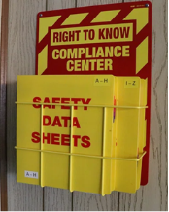
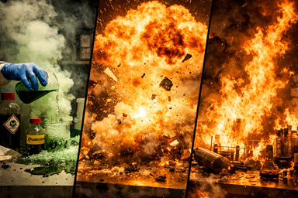
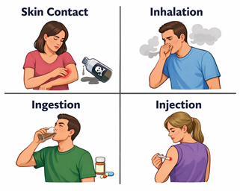

Factory Safety (2 of 2)
Material Safety Data Sheet (MSDS)
Physical Data (melting/boiling/flash-points)
Toxicity, First aid, Fire-fighting, …
Physical Hazards:
Fire, Explosion, Chemical Exposure, Freezing
Health Hazards:
Irritants, Toxins, Carcinogens
Acute vs. Chronic
Exposure Types:
Skin contact, Inhalation, Ingestion, Injection
(PD) U.S. Government
ChatGPT / Matt Pierce, 2026
ChatGPT / Matt Pierce, 2026
ChatGPT / Matt Pierce, 2026
Notes:
Image Credits:
MSDS Sheet Pic = Google “vector msds logo” = (CC0) - https://www.rawpixel.com/image/11071842/photo-image-fire-public-domain-red
ChatGPT – Physical Hazards: “make a picture showing chemical exposure leading to explosion leading to fire
ChatGPT – Health Hazards: “make a picture showing health hazards including irritants, toxins, carcinogens and what the difference is between them using pictures not words” + “Remove the lowest section titled differences. everything else is perfect.“
ChatGPT – Exposure Types: “Irritants, Toxins, carcinogens”
e

Slide 14
Q&A

Slide 15
Practice Q&A’s (Q1-Q8)
Q5: What transverse, solid disc assembly provides a pressure seal, attachment points for wings and longerons, and supports heavy loads?
A: Bulkhead
Q6: What open ring assembly is like a bulk-head, but has an open concentric middle?
A: Former
Q7: What large longitudinal (nose to tail) part manages bending and torsion loads?
A: Longerons
Q8: What small and plentiful part provides local stiffening and skin support?
A: Stringers
Q1: What are the five components of an airframe?
A: Fuselage, wings, tail assembly, elevator, and landing gear
Q2: What type of fuselage construction were old 1917-era biplanes?
A: Truss
Q3: What is the most common type of fuselage since the 1940s (typically aluminum)?
A: Semi-Monocoque
Q4: What is the type of fuselage typically used in composite airplanes?
A: Monocoque

Slide 16
Practice Q&A’s (Q9-Q16)
Q13: What is the main structural part of a wing that runs perpendicular and gives it the contour shape?
A: Ribs
Q14: What covers the wing providing aerodynamic shape for lift, is light, rigid and easily bends?
A: Skin
Q15: What are the three most common current types of wing skin?
A: Aluminum, Fiberglass, and Carbon Fiber
Q16: What type of hazard are fire, explosion, chemical exposure, and freezing?
A: Physical hazards
Q9: What part forms the external shell, providing aerodynamic shape, a pressure seal, and strengthens the airframe?
A: Skin
Q10: What part is used all over and holds everything together?
A: Fasteners
Q11: What is the main structural part of a wing that runs parallel and is high strength and flexible?
A: Spars
Q12: What is the smaller part of a wing that also runs parallel, is not load bearing, but provides skin attachment points?
A: Stringers

Slide 17
Practice Q&A’s (Q17-Q24)
Q21: What tail type allows for shorter take-off?
A: Low-tail (lower speed lift-off / less turbulent air)
Q22: Which wing location has a wing box connection for strength?
A: High- and low-wing. Mid-wing cannot have a box thru the “tube”, so must build them integrated robustly without a wingbox.
Q23: Why are landing gear built to retract (expensive)?
A: To reduce drag
Q24: Which type of landing gear is cheaper and older, but more difficult to handle on the ground?
A: Conventional (that’s why you see tricycle on all commercial aircraft…except seaplanes)
Q17: What type of hazards are irritants, toxins, and carcinogens?
A: Health hazards
Q18: What types of exposure can lead to physical and health hazards?
A: Skin contact, inhalation, ingestion, and injection
Q19: What are some basic configurations of an airplane?
A: Location of wing (high, mid, low). Number of engines. Design of tail section (high, mid, low horizontal stabilizer).
Q20: What wing type allows for shorter take-off?
A: High-wing (higher lift at low speeds)

Slide 18
Practice Q&A’s (Q25-Q32)
Q30: Federal agency from course 101 that oversees all Aviation in the U.S.?
A: FAA (Federal Aviation Administration)
Q31: What document identifies the PPE you should use for a given sealant application process?
A: Engineering Process Document
Q32: What should you do in case of a chemical harm incident? A: Follow MSDS (Material Safety Data Sheet) instructions on what to do in emergency (e.g.: wash eye for 5 min., etc.)
Q25: Where can powerplants by attached?
A: Wings, fuselage, or even the tail
Q26: What type of wing is the most stable?
A: High-wing.
Q27: What are the two primary power plant configurations?
A: Single-engine and multi-engine (2, 3, 4…)
Q28: What does PPE stand for?
A: Personal Protective Equipment (like glasses, face mask, respirator, etc.)
Q29: Federal agency for work hazard info?
A: OSHA – Occupational Safety & Health Admin

Slide 19
Thank You
Matt Pierce - mpierce710006@gmail.com - linkedin.com/in/mpiercead576/
https://github.com/DataResearchLabs/study_guide_intro_aerospace_mfg

